Slide 1
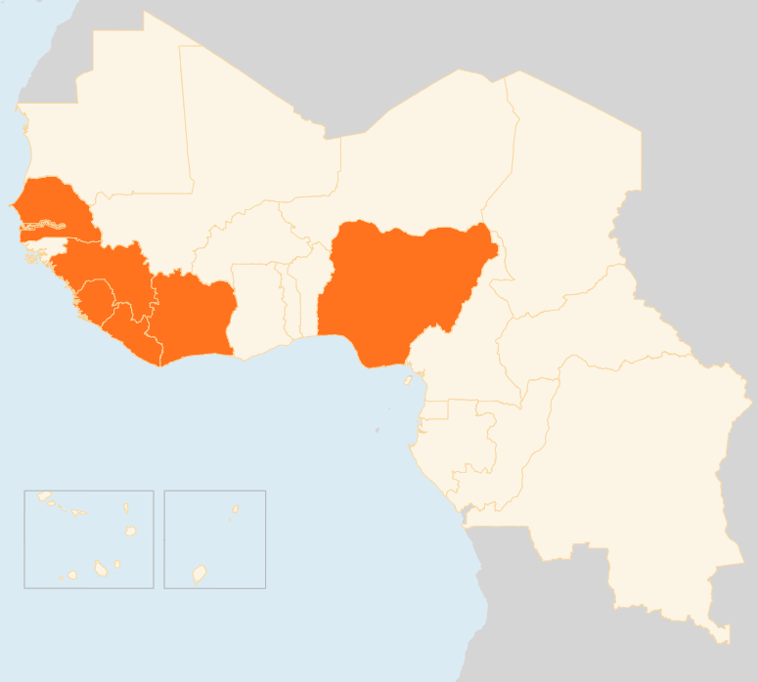

17 – 23 Mar 2015
COTE D’IVOIRE
IDPs SLOWLY RETURNING HOME
Around 500 people displaced by inter-community fighting that erupted on 9 March in Goin Débé forest in the country’s southwest have started returning home with the help of the community and the local administration. Sporadic inter-ethnic violence and attacks by armed groups continue to plague Côte d'Ivoire’s western region. Some 2,600 people are still displaced following armed raids on villages near the Liberian border earlier this year.
GUINEA
95 EVD CASES REPORTED, HIGHEST IN 2015
A total of 95 cases were reported in the week prior to 15 March, Guinea’s highest weekly number in 2015. Trends in the past fortnight suggest that infections are largely being spread through unknown chains of transmission as less than 30 percent of confirmed cases were from registered contacts and almost half of the deaths reported were confirmed post-mortem within communities.
LIBERIA
FIRST EBOLA CASE IN 25 DAYS
Liberia reported its first confirmed EVD case in 25 days. A female patient was taken ill on 18 March in a Monrovia hospital and later transferred to an MSF-run Ebola treatment centre. The exact circumstances of the infection are not yet known. About 100 people (contacts) are to be traced, including a number of students in schools where the patient sold food.
NIGERIA
11 KILLED IN INSURGENT ATTACK
Boko Haram insurgents on 18 and 19 March killed 11 civilians in Gamboru town in the northeastern Borno State, prompting Chadian forces to return to the town from which they had withdrawn after driving out the militants in February. Boko Haram has been forced out of several towns and localities in northeastern Nigeria ahead of the 28 March elections.
SENEGAL
400 MIGRANTS EVACUATED FROM CONFLICT-HIT LIBYA
A total of 401 Senegalese migrants have been evacuated from Libya by IOM. On 20 March, 130 migrants arrived home, the third such airlift since the operation started on 27 February. Most of the migrants worked informally in Tripoli until mid-December when they were seized in a raid and taken to a holding facility in the north-western Misrata city. Another group is still in Sebha city in the southwest and will be evacuated later.
REGIONAL / EBOLA VIRUS DISEASE (EVD)
30 PERCENT RISE IN WEEKLY CASES
In the week that ended on 15 March, 150 cases were reported from Guinea and Sierra Leone, 34 more than the week before. A total of 24,666 suspected, probable and confirmed cases resulting in 10,179 deaths have been reported from the three West African countries struggling to curb Ebola.
SENEGAL
400
EVACUATED
FROM LIBYA
GUINEA
95
EVD CASES, HIGHEST IN 2015
NIGERIA
11
KILLED IN
INSURGENT ATTACK
COTE D’IVOIRE
500
IDPS RETURN
HOME
LIBERIA
REGIONAL / EVD
1
EBOLA CASE, FIRST IN 25 DAYS
30
PERCENT RISE
IN CASES
Creation date: 25 March 2015
Map data sources: UNCS, DevInfo, OCHA.
The boundaries and names shown and the designations used on this map do not imply official endorsement or acceptance by the United Nations

